Slide 1
Moneyball 2.0
An Examination of America’s Pastime
Shawn Williams
Mark Williams

Slide 2

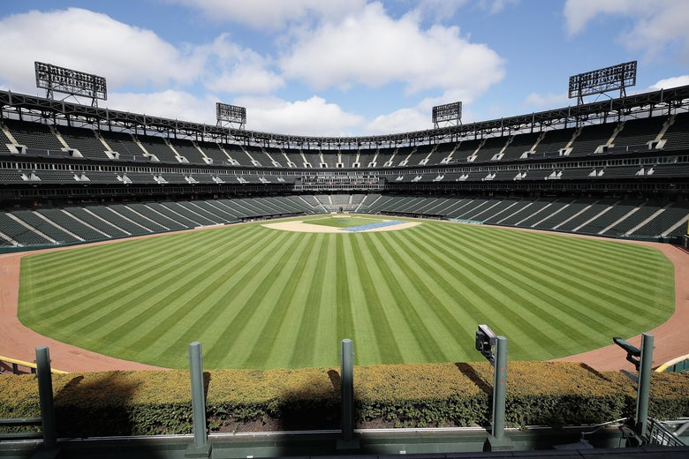
Project Purpose
Extracted MLB data from (1969-Present)
Determined which statistical categories were relevant to our overall objective
Built models to predict WS winners by team and league from (’15 -’20)

Slide 3
Models

Slide 4
Visuals

Slide 5
HTML

Slide 6
Conclusion

Slide 7
Lessons Learned

Slide 8
Project Sources
http://www.seanlahman.com/baseball-archive/statistics (MLB Data)
https://slate.com/news-and-politics/2020/06/mlb-players-restart-2020-baseball-season-schedule-rules-changes-spring-training.html (Image)
https://www.mlb.com/stats/ (MLB Data)

